Slide 1
Classes and Objects

Slide 2
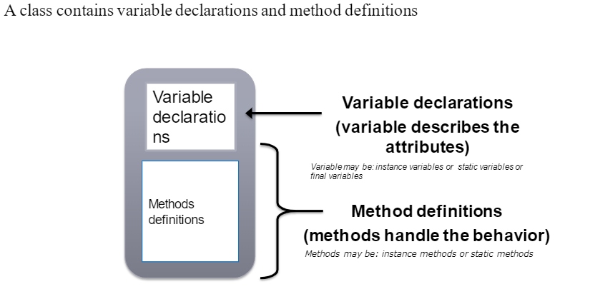
Classes

Slide 3
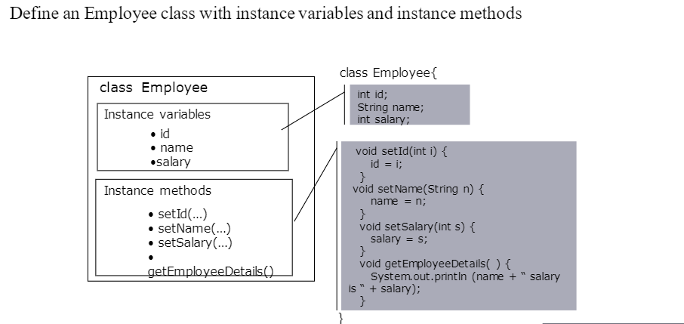
Defining a class in Java

Slide 4
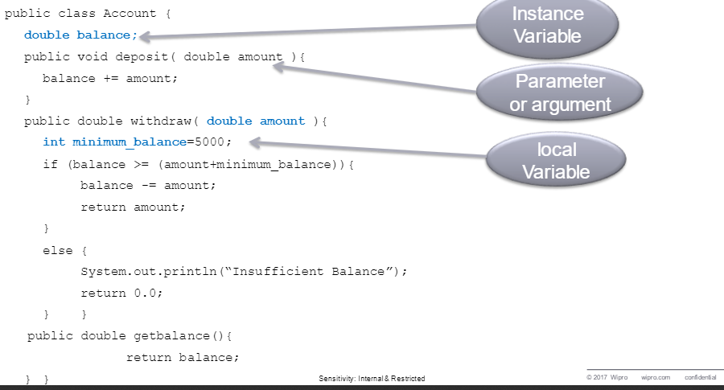
Basic information about a class

Slide 5
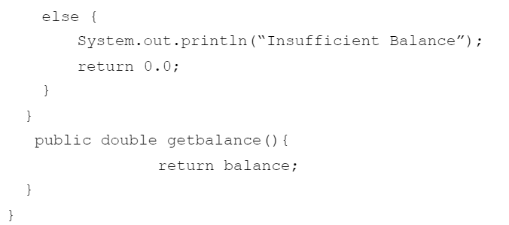
Basic information about a class

Slide 6
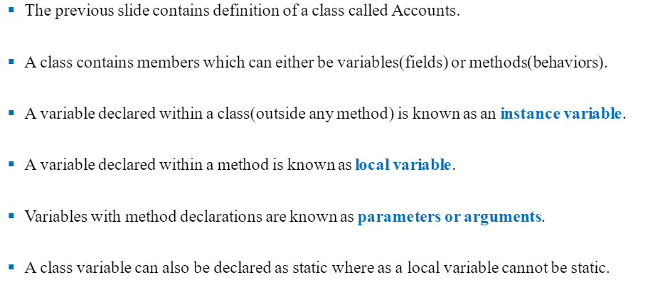
Member variable

Slide 7
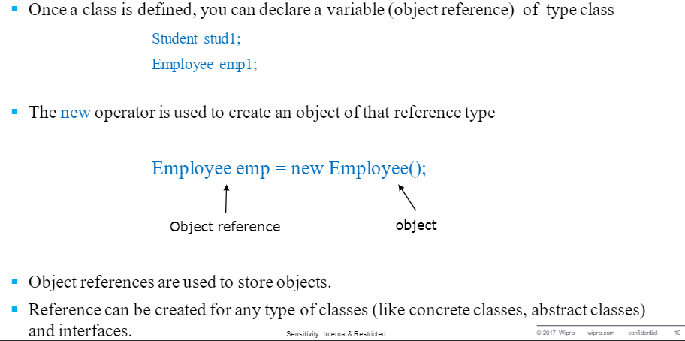
Object and References

Slide 8
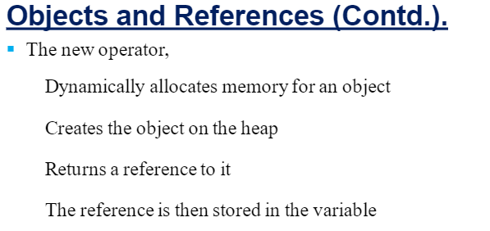

Slide 9
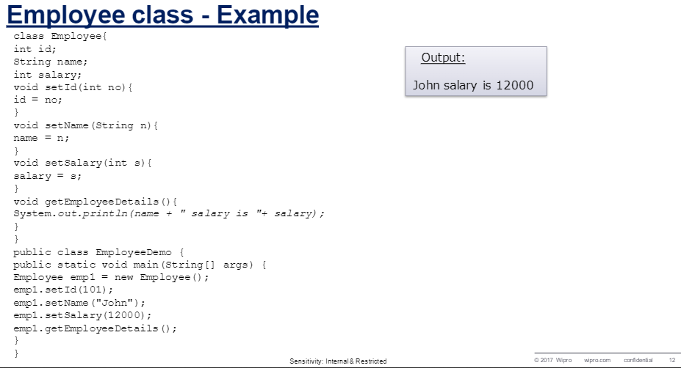

Slide 10
Trace Code
Classes and Objects
Declare myBox
Box myBox = new Box();
Box yourBox = new Box();
yourBox.width = 100;
yourBox.height = 10;
yourBox.depth= 50;
myBox
null

Slide 11
Trace Code, cont.
Classes and Objects
Box myBox = new Box();
Box yourBox = new Box();
yourBox.width = 100;
yourBox.height = 10;
yourBox.depth= 50;
myBox
null
Box
Width
Height
Depth
Create a Box

Slide 12
Trace Code, cont.
Classes and Objects
Box myBox = new Box();
Box yourBox = new Box();
yourBox.width = 100;
yourBox.height = 10;
yourBox.depth= 50;
myBox
reference value
Assign object reference to myBox
Box
Width
Height
Depth

Slide 13
Trace Code, cont.
Classes and Objects
Box myBox = new Box();
Box yourBox = new Box();
yourBox.width = 100;
yourBox.height = 10;
yourBox.depth= 50;
myBox
reference value
Box
Width
Height
Depth
yourBox
null
Declare yourBox

Slide 14
Trace Code, cont.
Classes and Objects
Box myBox = new Box();
Box yourBox = new Box();
yourBox.width = 100;
yourBox.height = 10;
yourBox.depth= 50;
myBox
reference value
Box
Width
Height
Depth
yourBox
null
Create a new Box object
Box
Width
Height
Depth

Slide 15
Trace Code, cont.
Classes and Objects
Box myBox = new Box();
Box yourBox = new Box();
yourBox.width = 100;
yourBox.height = 10;
yourBox.depth= 50;
myBox
reference value
Box
Width
Height
Depth
yourBox
reference value
Assign object reference to yourBox
Box
Width
Height
Depth

Slide 16
Trace Code, cont.
Classes and Objects
Box myBox = new Box();
Box yourBox = new Box();
yourBox.width = 100;
yourBox.height = 10;
yourBox.depth= 50;
myBox
reference value
Box
Width
Height
Depth
yourBox
reference value
Change variables in yourBox
Box
Width =100
Height=10
Depth =50

Slide 17
Trace Code, cont.
Classes and Objects
Box myBox = new Box();
Box yourBox = new Box();
yourBox.width = 100;
yourBox.height = 10;
yourBox.depth= 50;
myBox = yourBox;
myBox
reference value
Box
Width
Height
Depth
yourBox
reference value
Box
Width =100
Height=10
Depth =50
Assigning Object Reference Variables

Slide 18
Garbage Collection
When no references to an object exist, that object is assumed too be no longer needed, and the memory occupied by the object can be reclaimed.
As shown in the previous figure, after the assignment statement myBox = yourBox, myBox points to the same object referenced by yourBox. The object previously referenced by myBox is no longer referenced. This object is known as garbage. Garbage is automatically collected by JVM.

Slide 19
Garbage Collection, cont…
If you know that an object is no longer needed, you can explicitly assign null to a reference variable for the object. The JVM will automatically collect the space if the object is not referenced by any variable.

Slide 20
The finalize() Method
Sometimes an object will need to perform some action when it is destroyed.
The garbage collector calls a special method named finalize in your object if that method exists.
If an object hold some non-Java resources (file handle or window character font) or any reference to other objects, these resources can be freed using finalize method.
Avoiding circular reference.
protected void finalize()
{
//finalization code here
}

Slide 21
Circular References
Class a{
b b1;
a(){ b1 = new b();}
}
Class b{
a a1;
b(){ a1 = new a();}
}
public class app
{
public static void main(String args[])
{
a obj = new a();
obj = null;
}
}
obj
reference value
b1
a1

Slide 22
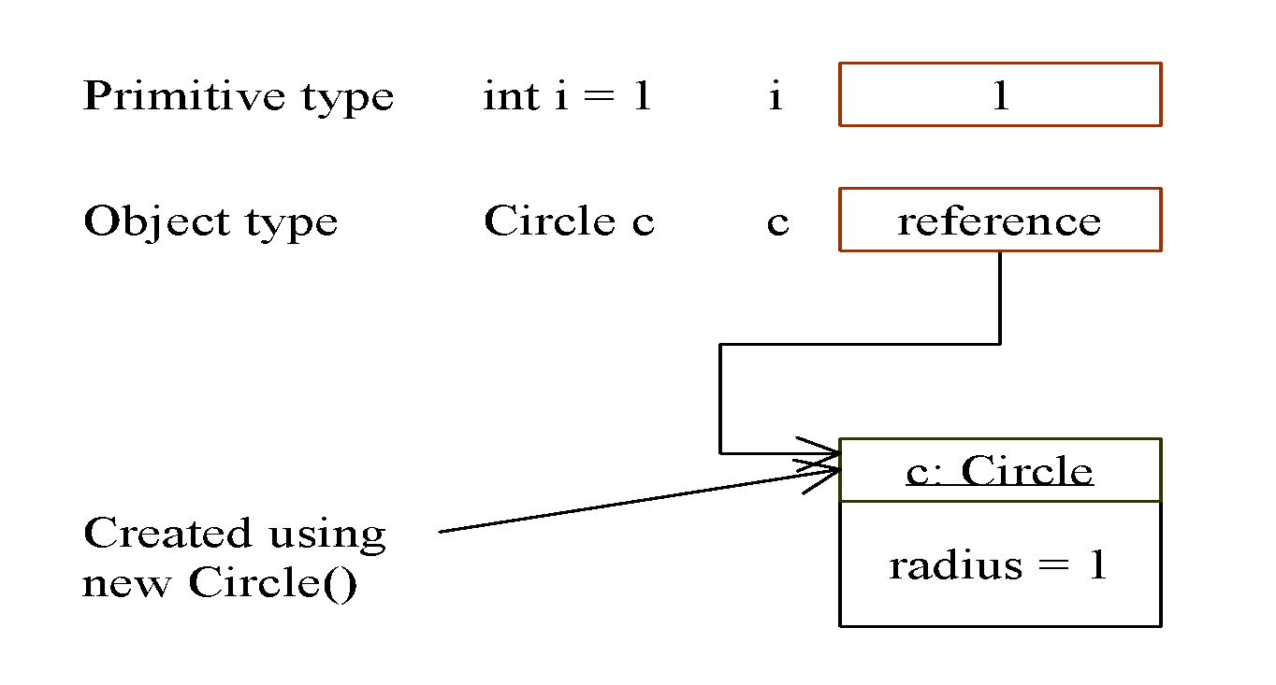
Differences between Variables of Primitive Data Types and Object Types

Slide 23
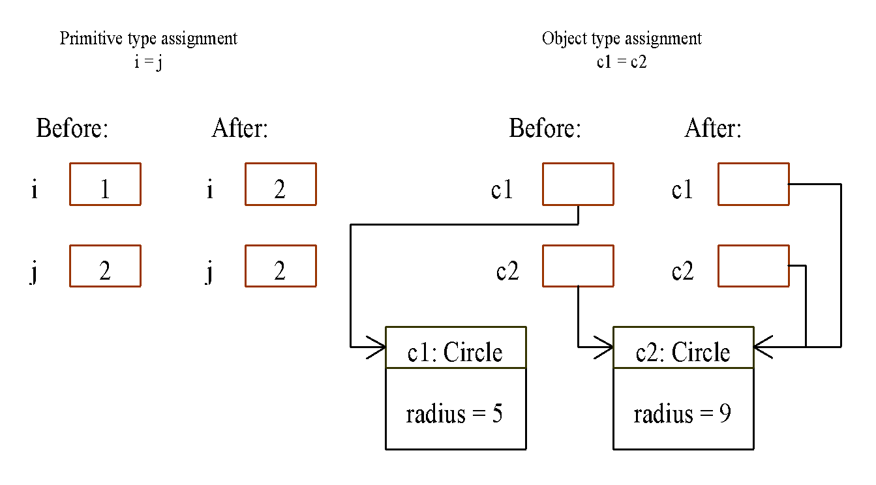
Copying Variables of Primitive Data Types and Object Types

Slide 24
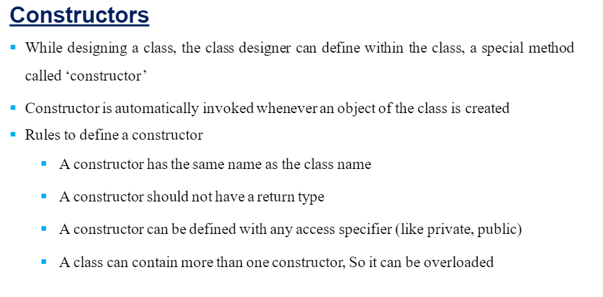

Slide 25
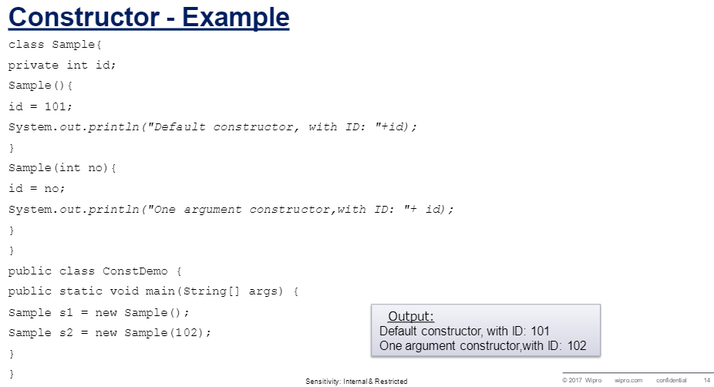

Slide 26
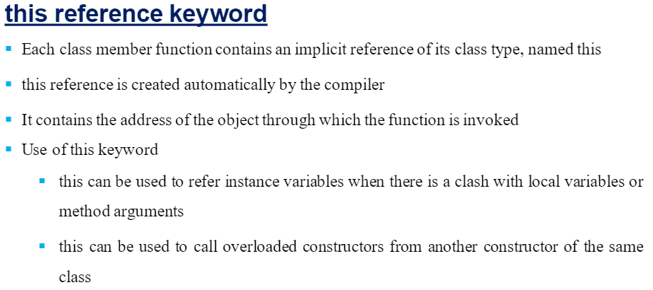

Slide 27
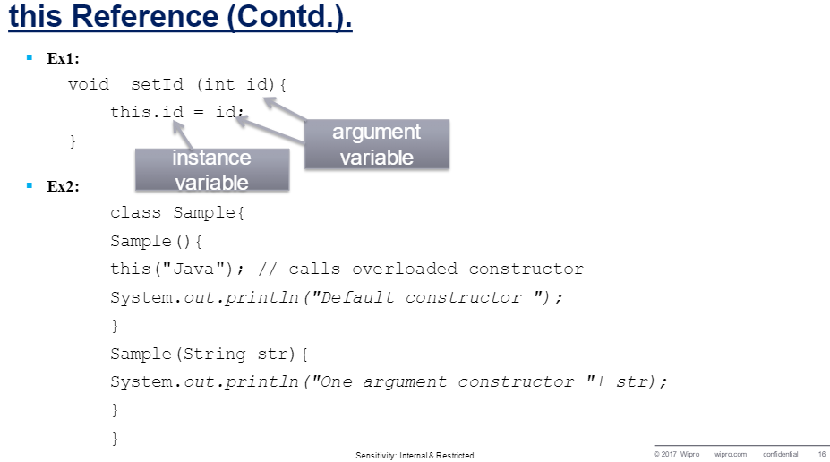

Slide 28
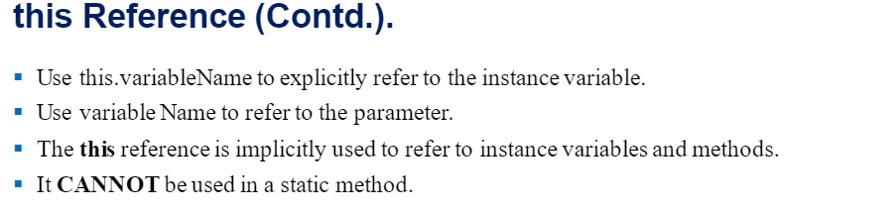

Slide 29
class Data
{
private String data_string;
Data(String S){data_string = s;}
public String getData(){return data_string;}
public void printData()
{
Printer p = new Printer();
p.print(this);
}
}
class Printer
{
void print(Data d){System.out.println(d.getData());}
}
public class app
{
public static void main(String args[])
{
(new Data(“Hello from Java”)).printData();
}
}

Slide 30
Using Objects as Parameters
An object of a class can be passed as parameter to both methods and constructors of a class.
/*construct a new object so that it is initially the same as some existing object.
Define a new constructor Box that takes an object of its class as a parameter.
*/
Box(Box ob){
Width = ob.Width;
Height = ob.Height;
Depth = ob.Depth;
}
Box myBox = new Box(10,20,15);
Box yourBox = new Box(myBox);

Slide 31
Using Objects as Parameters cont…
//objects may be passed to methods
class Test{
int a,b;
Test(int I, int j){
a = i;
b = j;
}
//return true if obj is equal to the invoking obbject
boolean equals(Test obj){
if(obj.a == a && obj.b == b) return true;
else return false;
}
}
Test ob1 = new Test(100, 22);
Test ob2 = new Test(100, 22);
Test ob3 = new Test(-1,-1);
ob1.equals(ob2); 🡪 true
Ob1.equals(ob3); 🡪false

Slide 32
Type of Argument Passing
Call-by-value:
When you pass an item of a simple data type to a method.
Method only gets a copy of the data item.
The code in the method cannot affect the original data item at all.
class Test{
void meth(int i, int j){
i=i*2;
j=j/2;
}
}
Test ob = new Test();
int a = 15, b = 20;
Systeem.out.println(“ a and b before call: “ +a+” “+b);🡪 15 20
ob.meth(a,b);
Systeem.out.println(“ a and b after call: “ +a+” “+b);🡪 15 20

Slide 33
Type of Argument Passing cont…
Call-by-reference:
When you pass an object to a method.
Java actually passes a reference to the object.
Code in the method can reach the original object.
Any change made to the passed object affect the original object.
class Test{
int a,b;
Test(int i, int j){
a = i;
b = j;
}
void meth(Test o){
o.a = o.a*2;
o.b = o.b/2;
}
}
Test ob = new Test(15,20);
Systeem.out.println(“ a and b before call: “ +a+” “+b);🡪 15 20
ob.meth(ob);
Systeem.out.println(“ a and b after call: “ +a+” “+b);🡪 30 10

Slide 34
Returning Objects from Methods
A method can return objects just like other data types.
The object created by a method will continue to exist as long as there is a reference to it.
No need to worry about an object going out-of-scope because the method in which it was created terminates.

Slide 35
Returning Objects Example
class Test{
int a;
Test (int i){
a = i;
}
Test incrByTen(){
Test temp = new Test(a+10);
return temp;
}
}
Class RetOb{
public static void main(String args[]){
Test ob1 = new Test(2);
Test ob2;
ob2 = ob1.incrByTen();
System.out.println(“ob1.a: “+ob1.a);
System.out.println(“ob2.a: “+ob2.a);
}
}
ob1.a = 2;
ob2.a = 12;

Slide 36
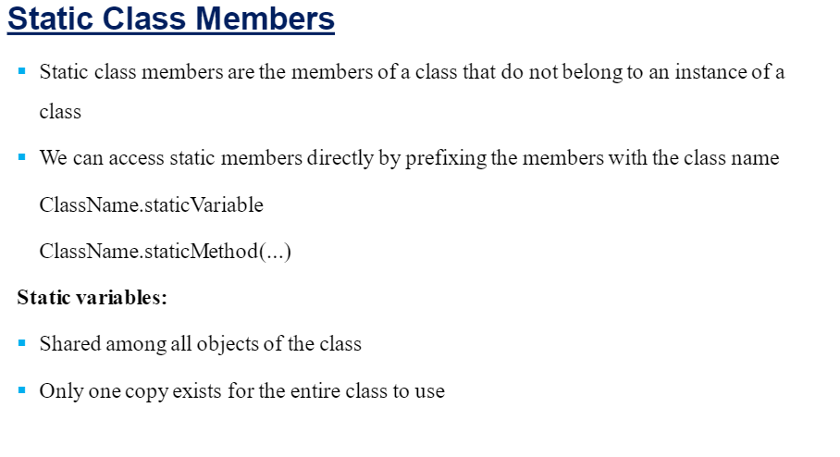

Slide 37
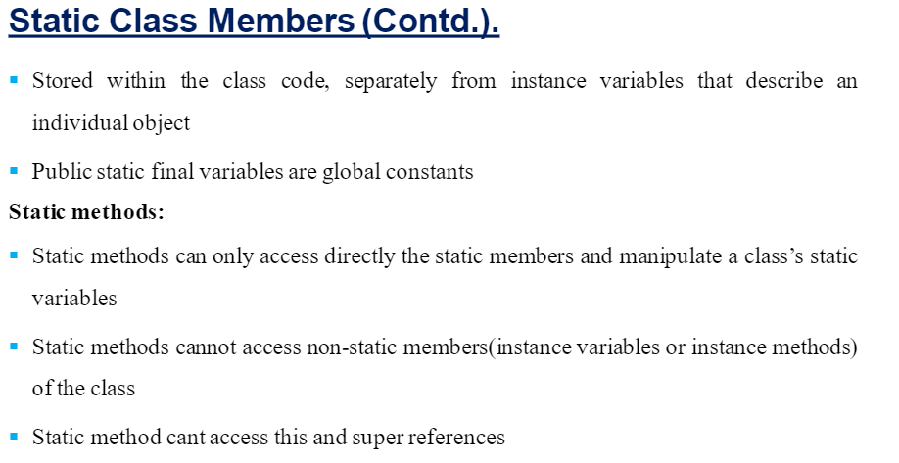

Slide 38
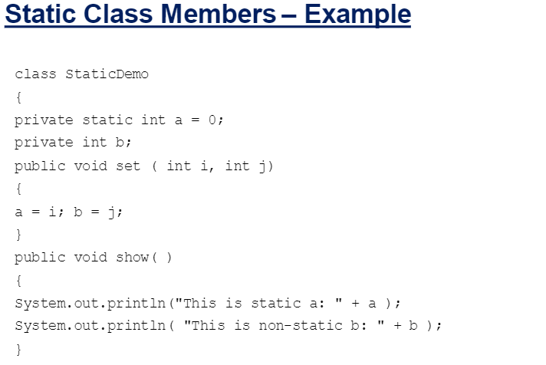

Slide 39
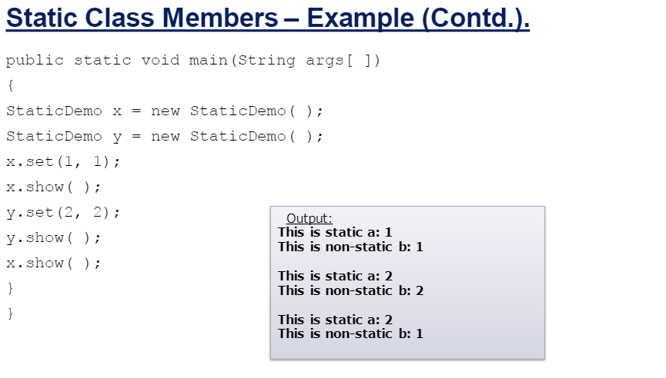

Slide 40
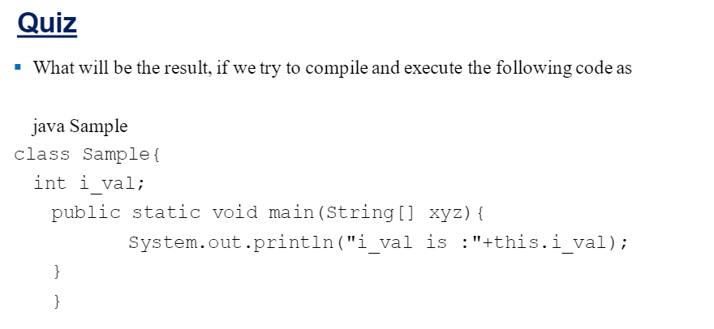

Slide 41
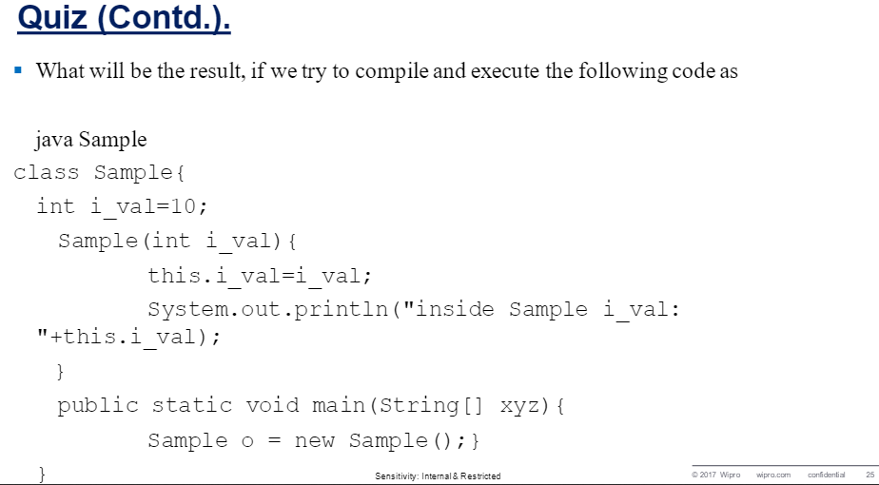

Slide 42
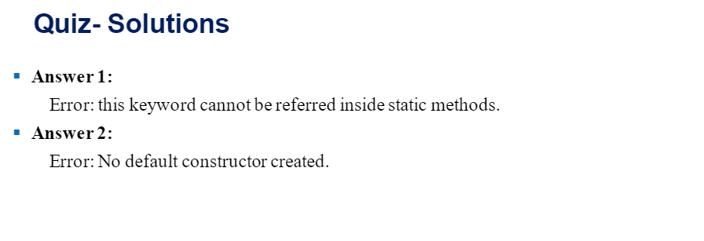

Slide 43
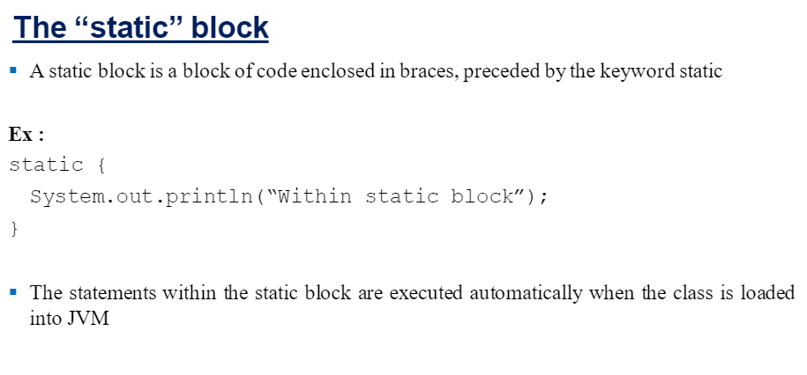

Slide 44
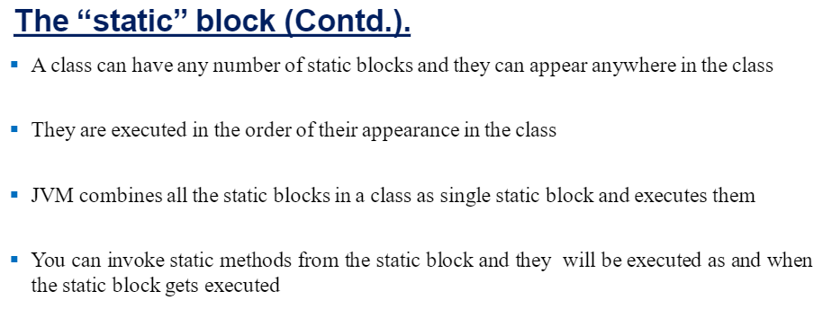

Slide 45
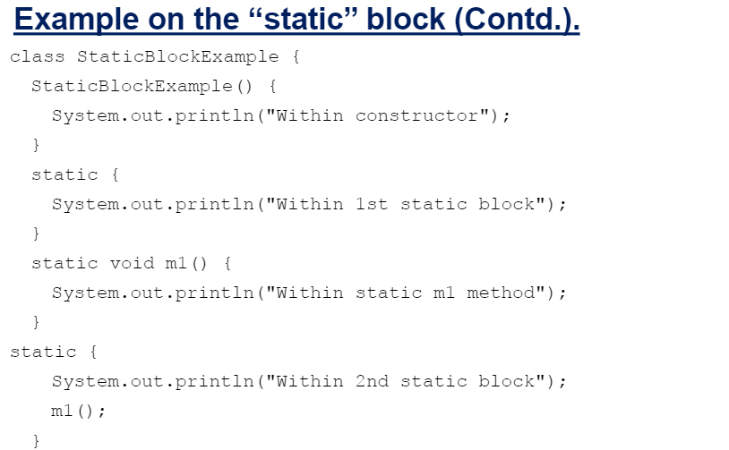

Slide 46
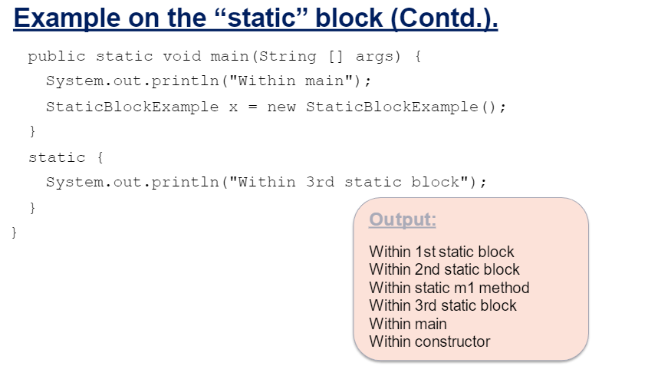

Slide 47
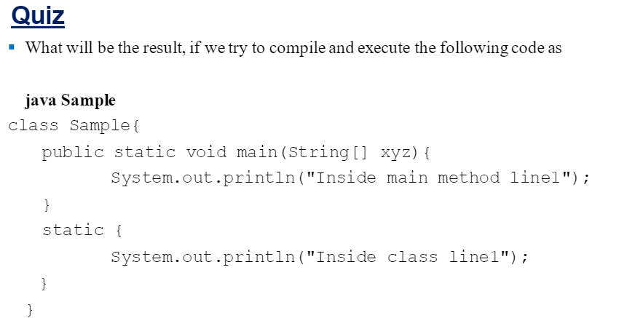
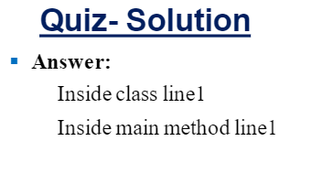

Slide 48


Slide 49
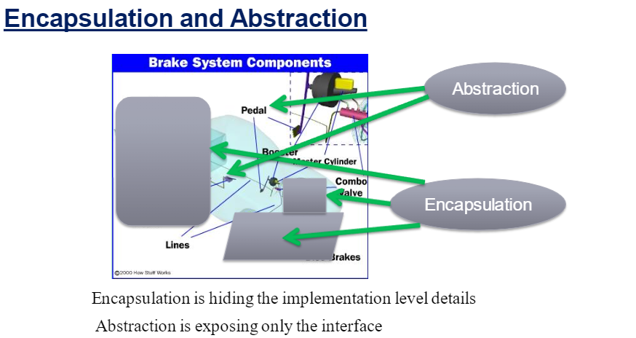

Slide 50
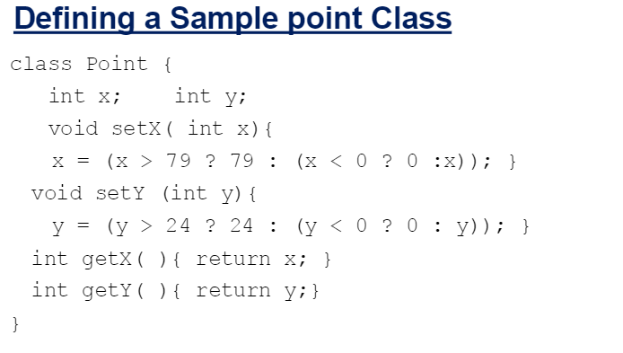

Slide 51
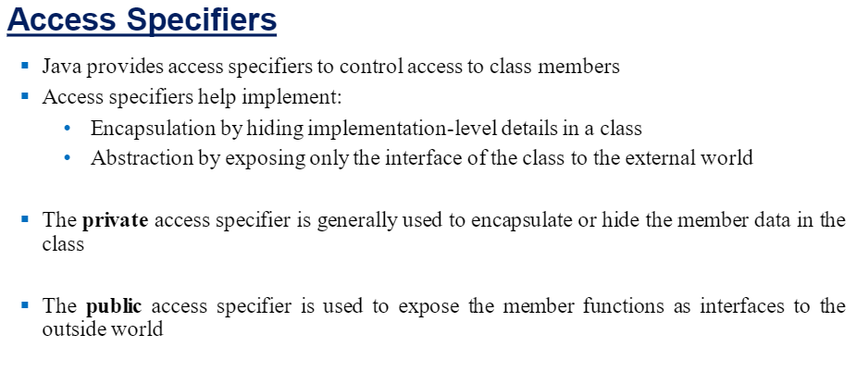

Slide 52
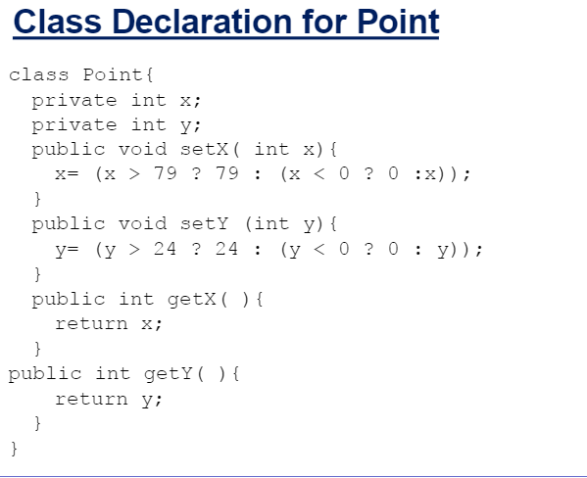

Slide 53
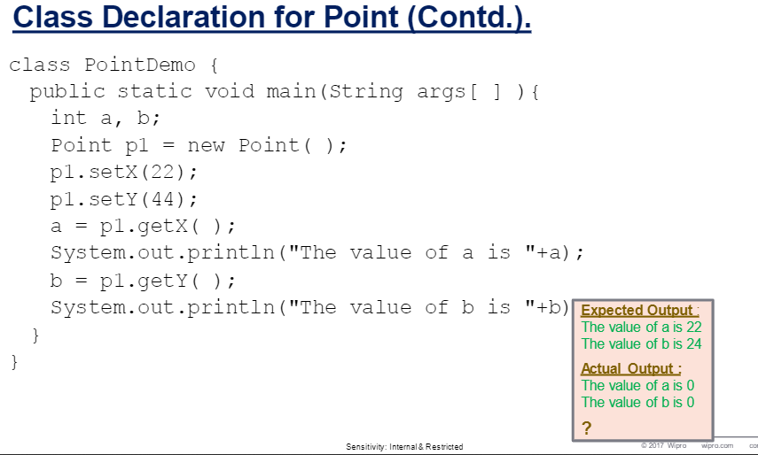

Slide 54
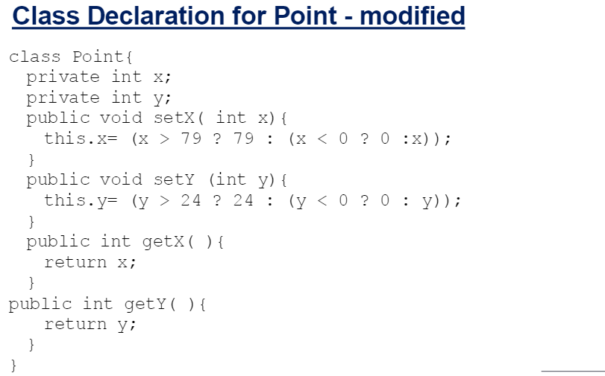

Slide 55
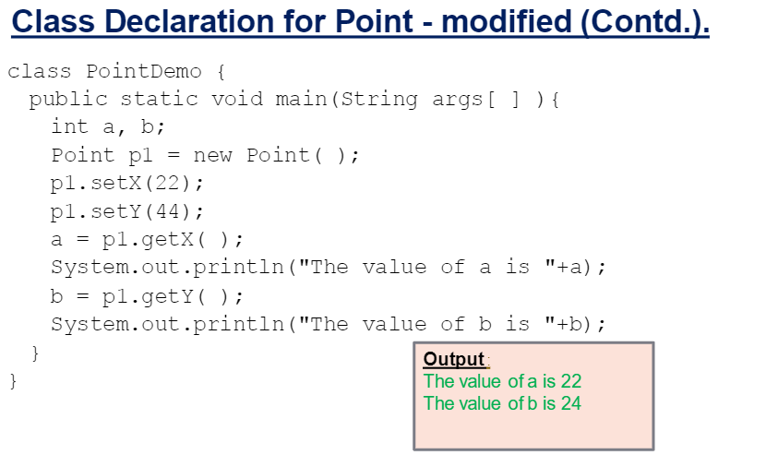

Slide 56


Slide 57
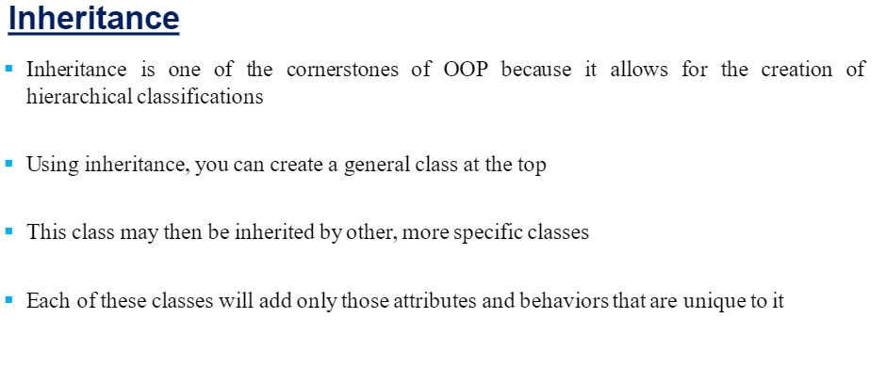

Slide 58
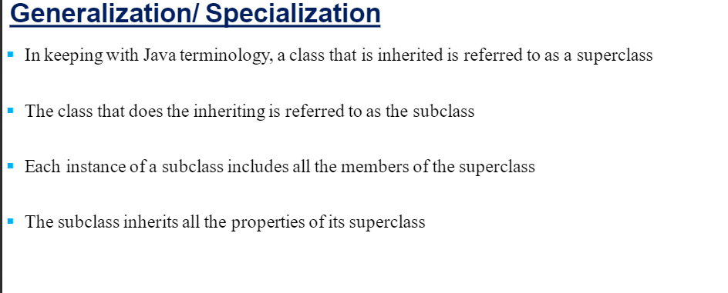

Slide 59


Slide 60
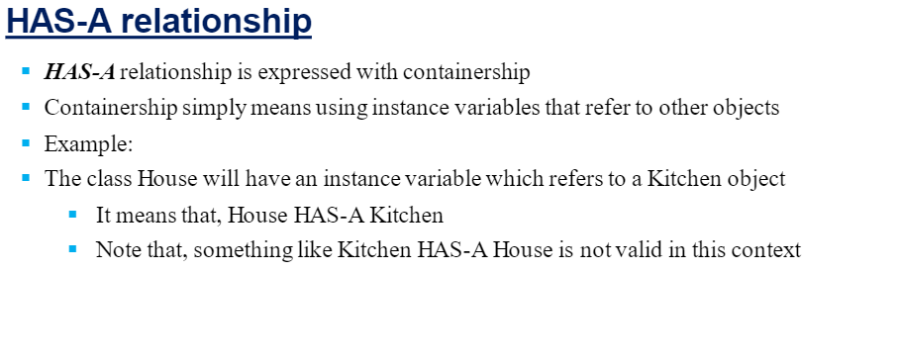

Slide 61
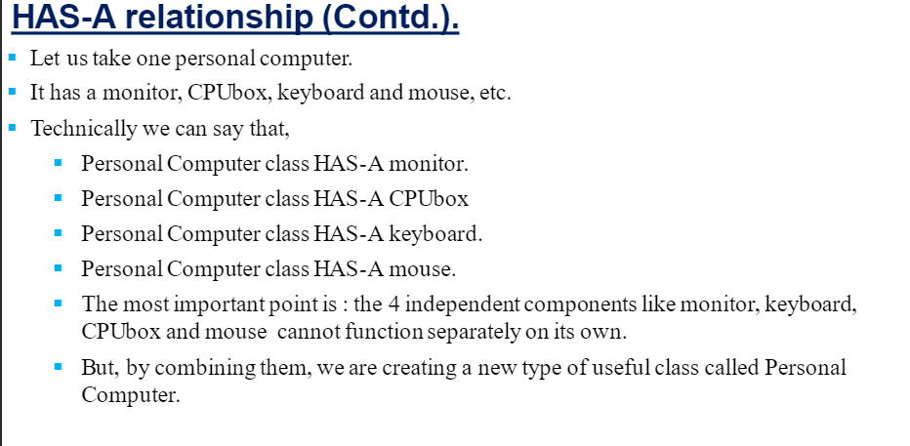

Slide 62
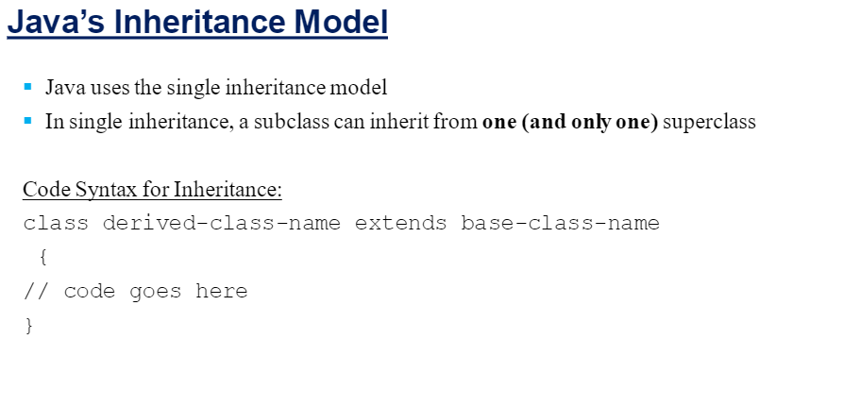

Slide 63
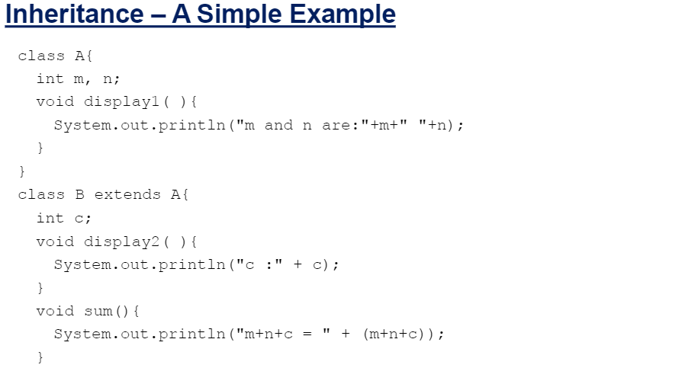

Slide 64
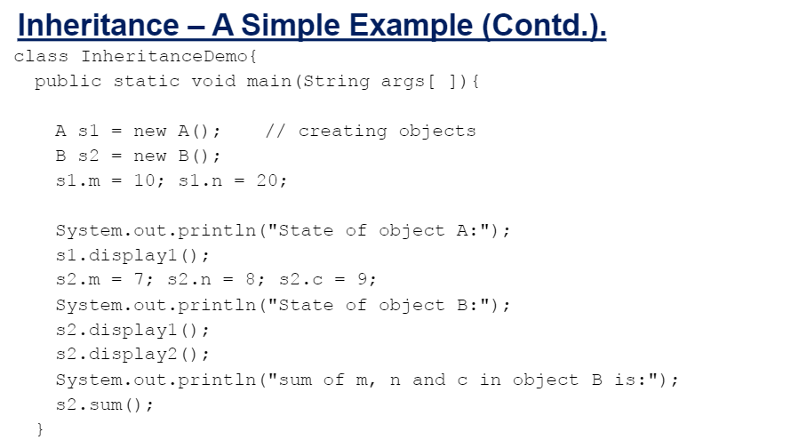

Slide 65
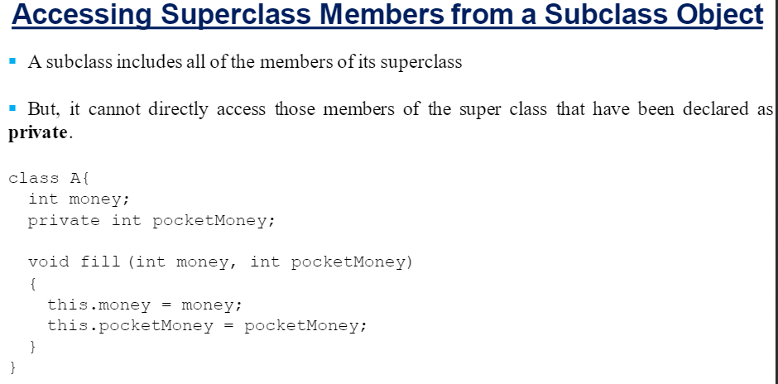

Slide 66
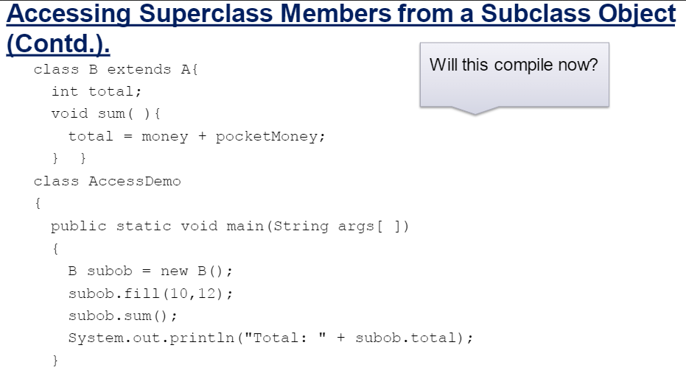

Slide 67
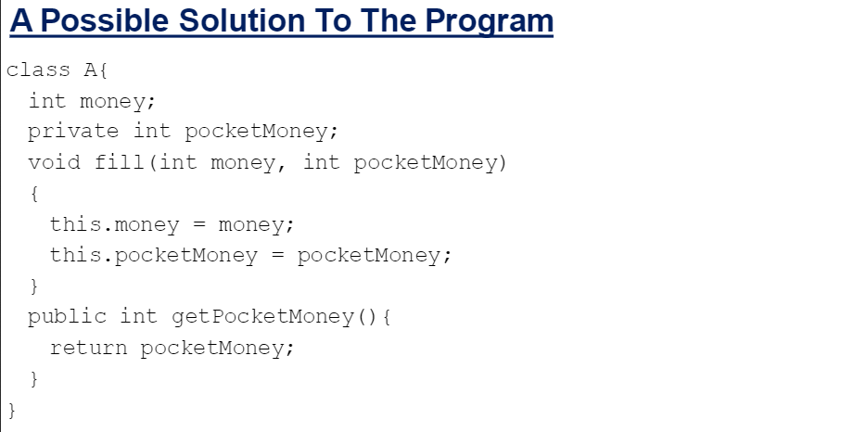

Slide 68
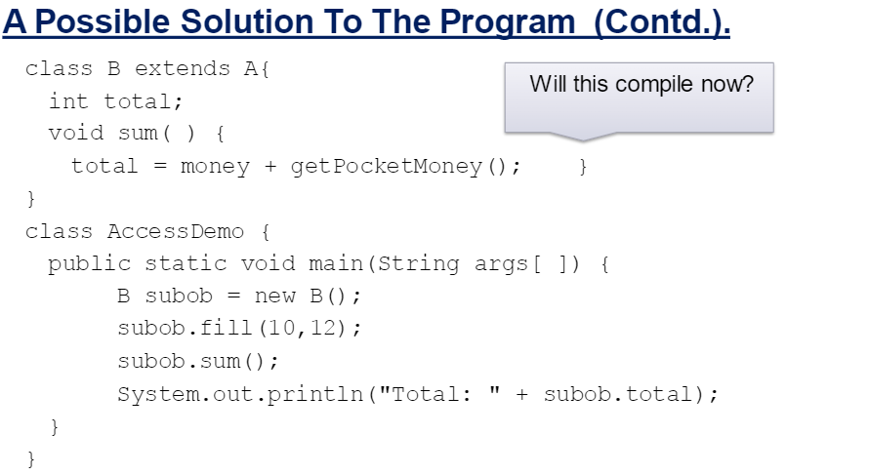

Slide 69
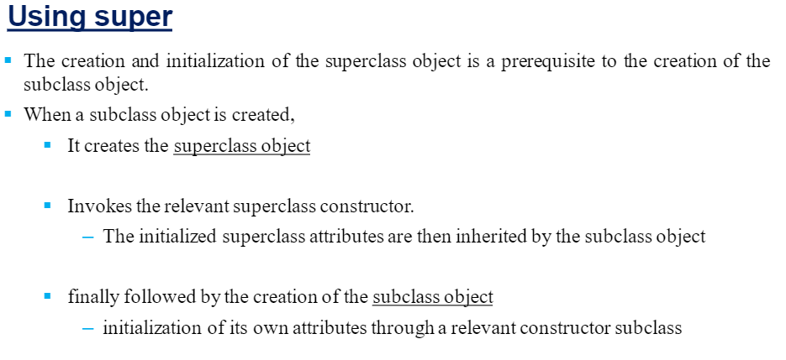

Slide 70
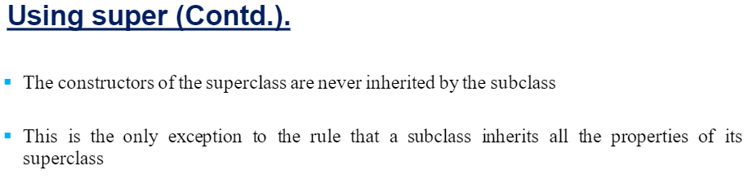

Slide 71
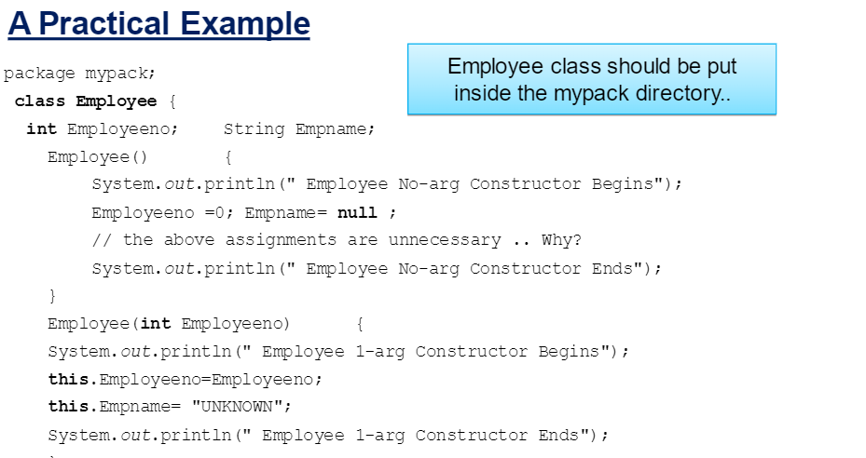

Slide 72
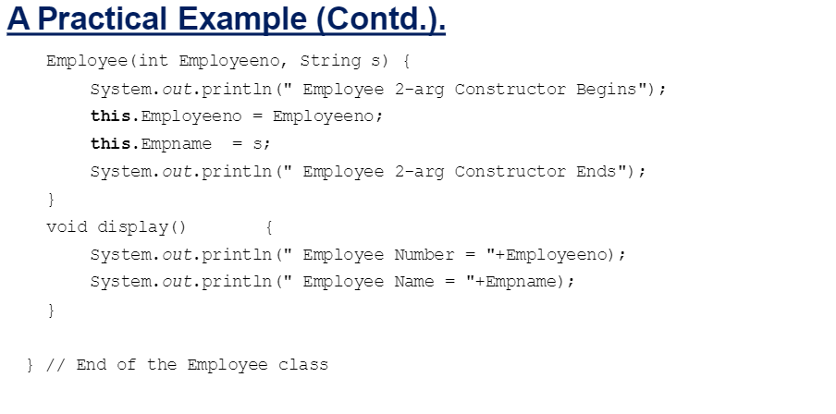

Slide 73


Slide 74


Slide 75


Slide 76


Slide 77


Slide 78


Slide 79


Slide 80


Slide 81


Slide 82


Slide 83


Slide 84


Slide 85


Slide 86


Slide 87


Slide 88


Slide 89


Slide 90


